Slide 1
R & QGIS: Integrating Statistical and Spatial Data Analysis
Class 3: Integrating R and QGIS

Slide 2
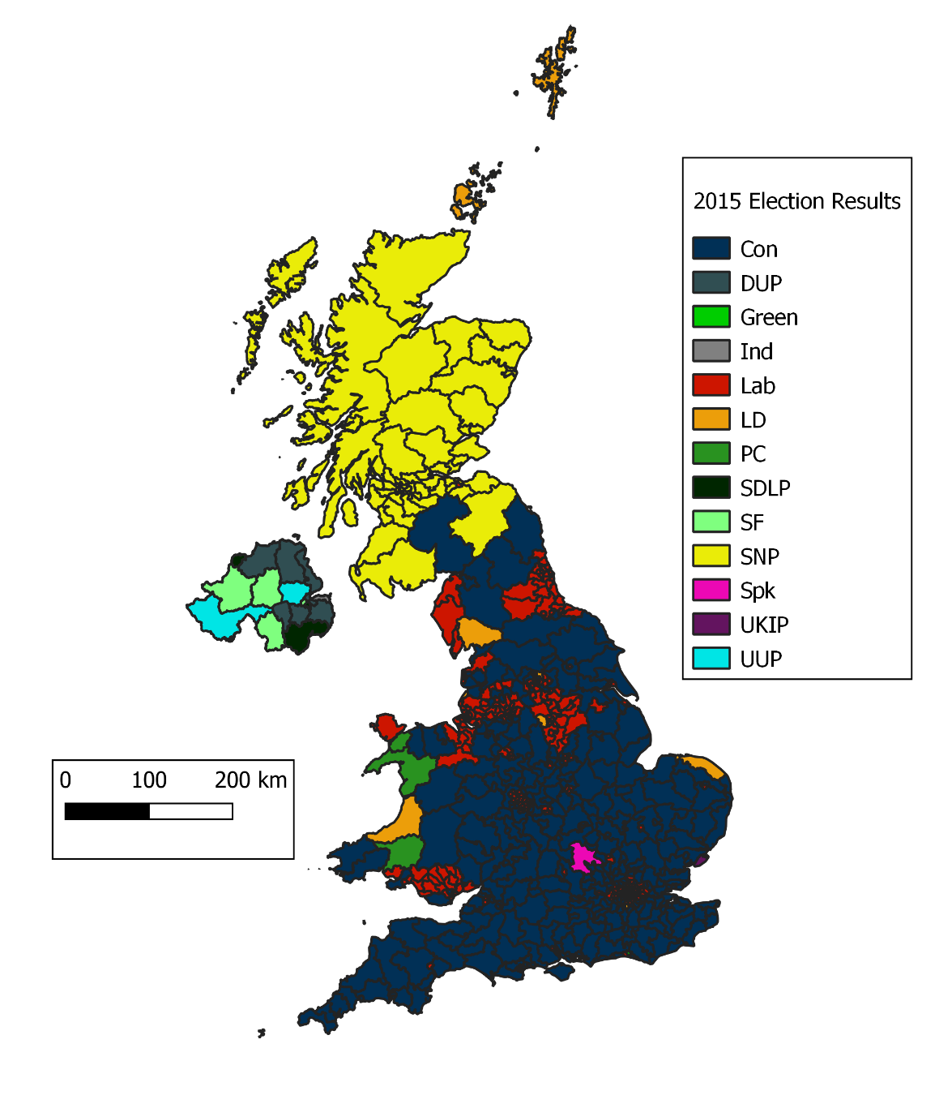
Before Starting…
Last Week’s Practical

Slide 3
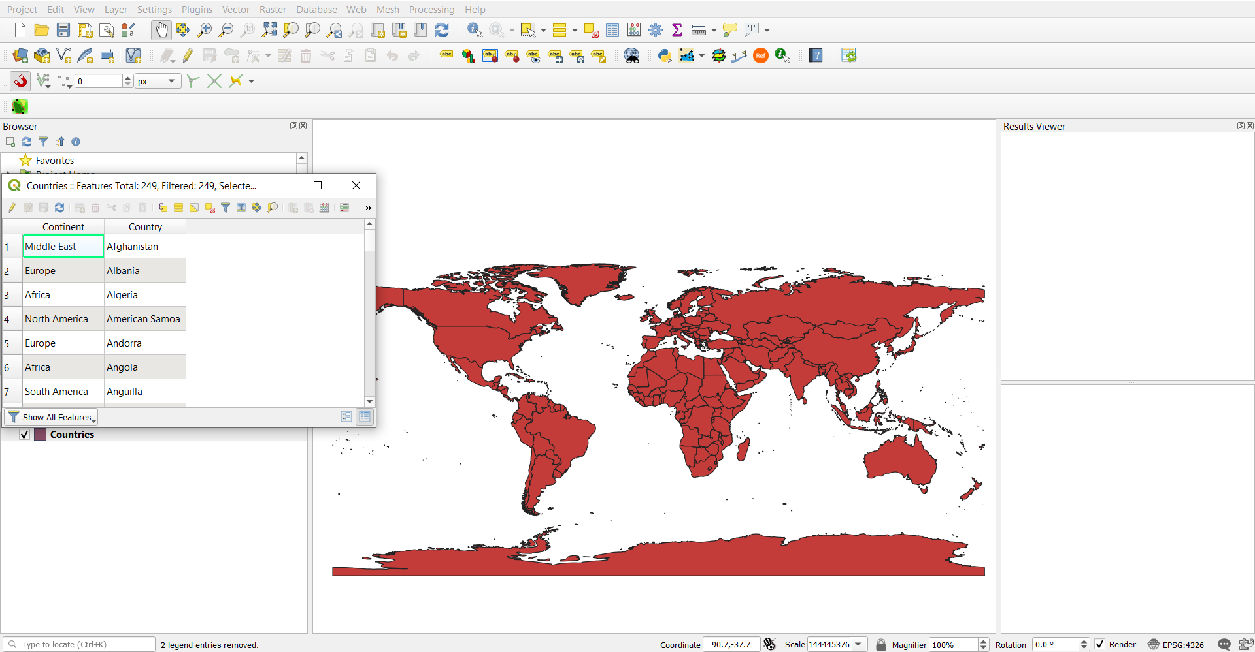
Import Data Again
Fairly easy to import
Click and drag .shp (in folder with the other required files)
Layer/Add Layer/Add Vector Layer

Slide 4
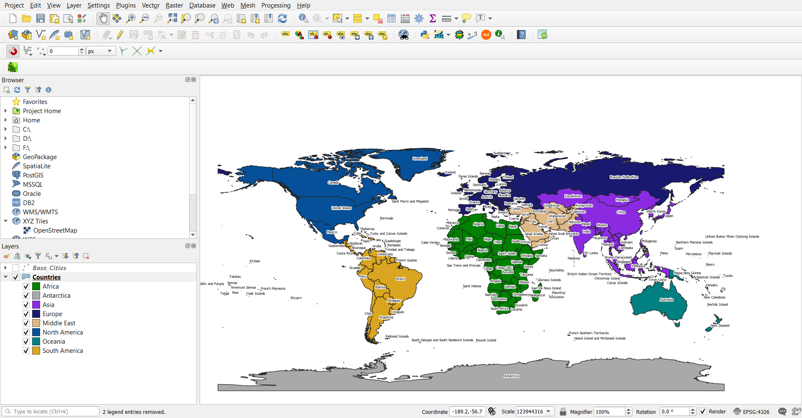
Some Basic Visualisation
Much like in R, we can visualise by colour
We can label with specific values from columns
You can save and load styles

Slide 5
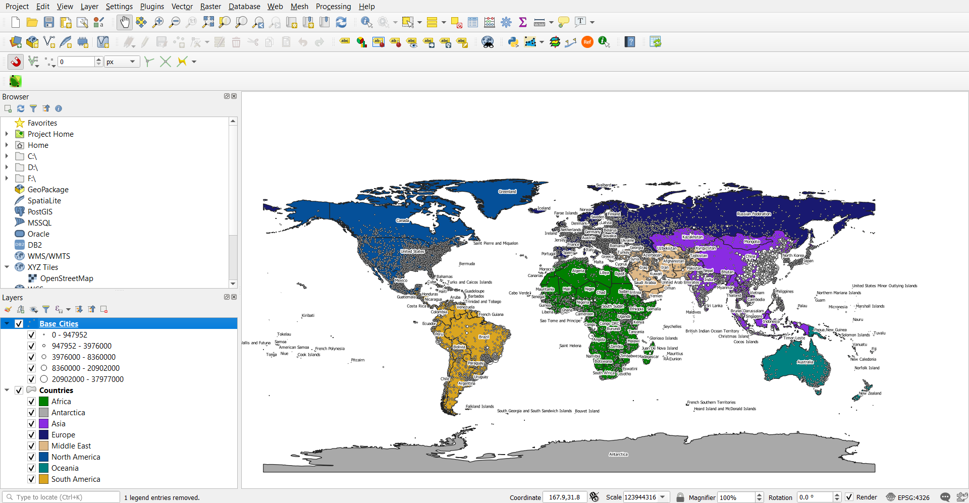
Some Basic Visualisation
We can add some cities point data by creating a new shapefile from Cities.csv (change the method to ‘Size’)
You can save and load styles

Slide 6
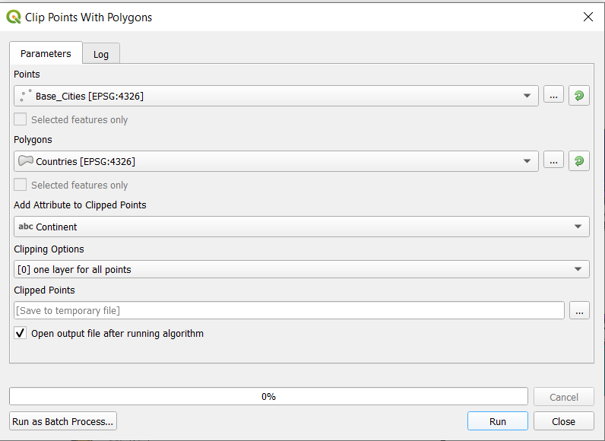
Beyond Visualisation
Use ‘Clip points with polygons’ to add additional data from polygons
You will need to export the resultant ‘Clipped’ layer in order to save it

Slide 7
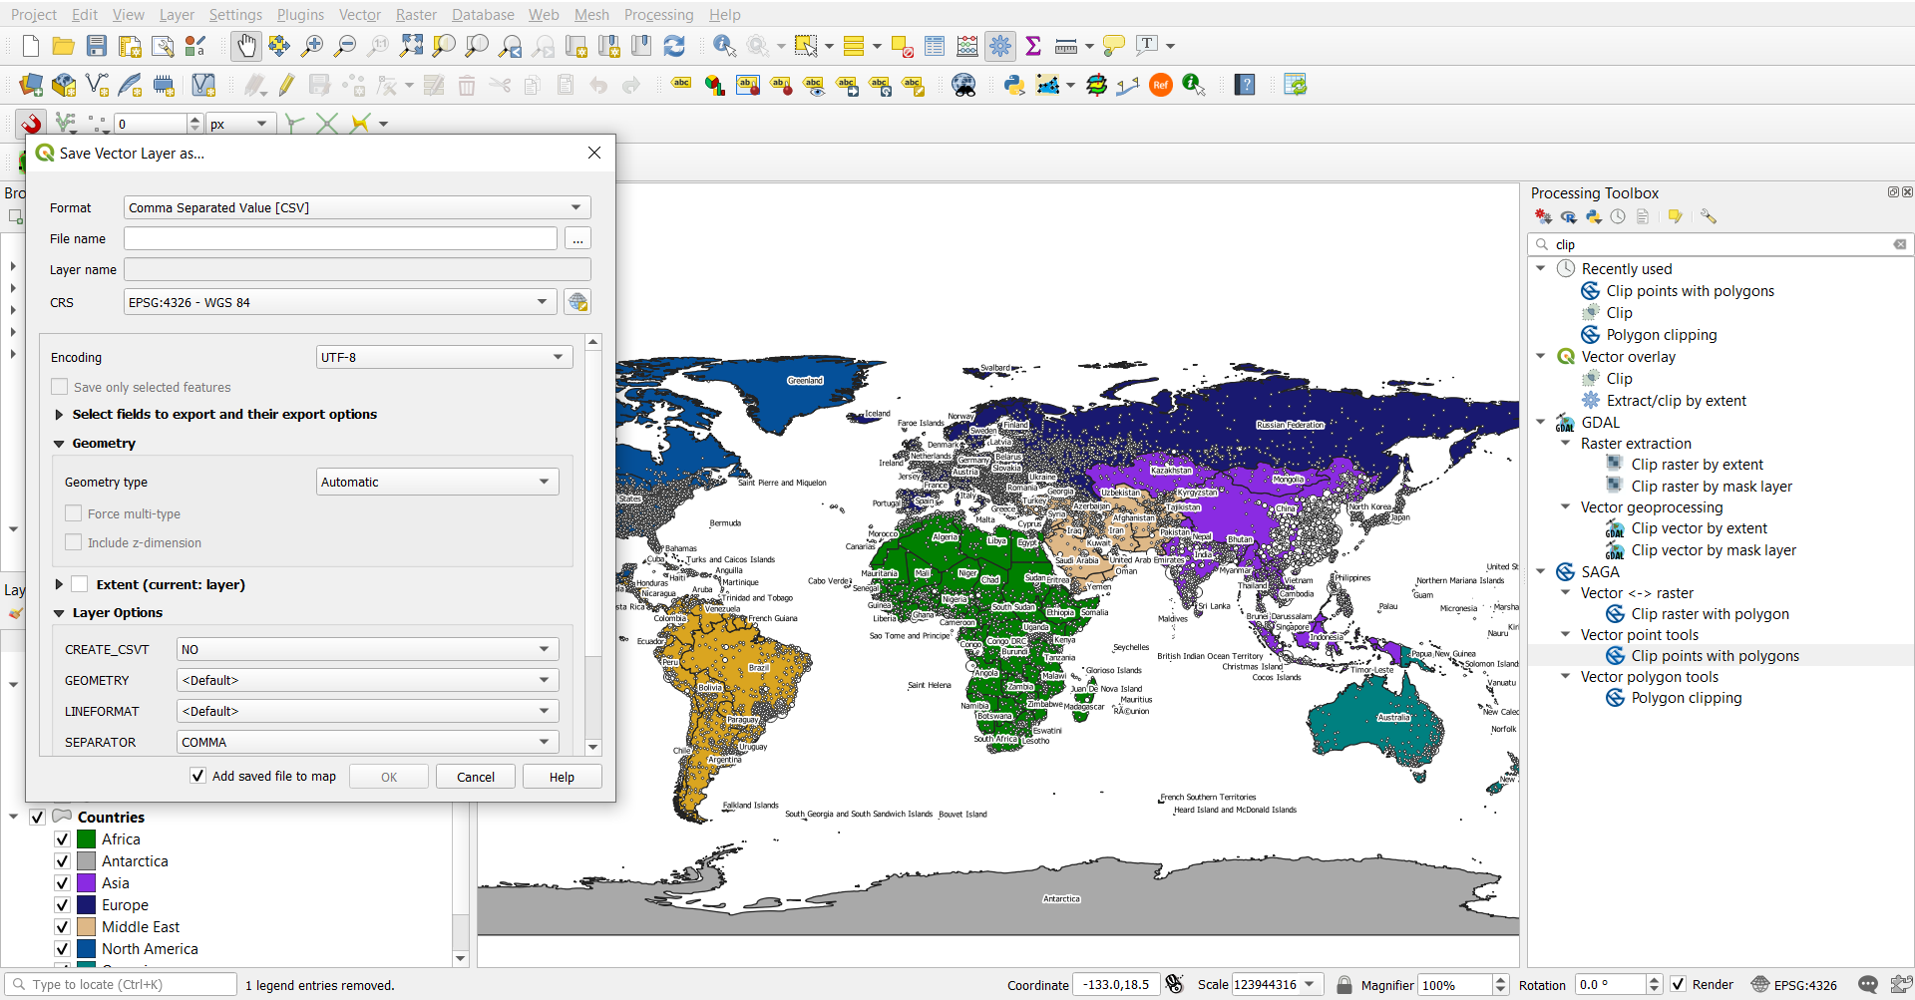
Exporting New Data
Now we can export our new data as a .csv for additional analysis in R

Slide 8
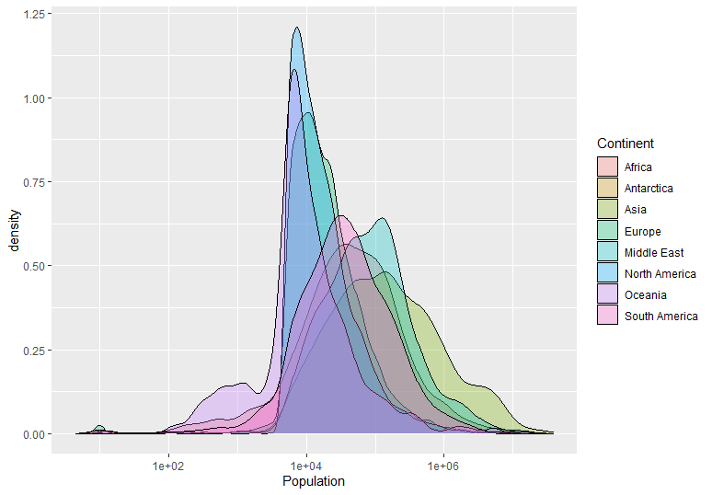
Analysis with R
Visualise the population values in R using ggplot
ggplot(Cities, aes(x=Population, fill=Continent))+geom_density(alpha=0.3)+scale_x_continuous(trans='log10')

Slide 9
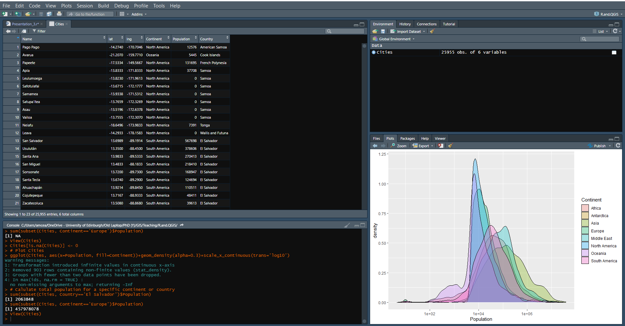
Analysis with R
We can then calculate the total urban population in each Country or Continent
Note, this can also be done in the QGIS field calculator
sum(subset(Cities, Country=='El Salvador')$Population) sum(subset(Cities, Continent=='Europe')$Population)

Slide 10
Analysis with R
group_by() can be used to create new data frames calculating the total populations for Countries or Continents
Any function can be used, e.g. mean population
The new data can then be exported if needed
Continent_Pop <- Cities %>%
group_by(Continent) %>%
summarise_at(vars(Population),
list(Urban_Population = sum, Mean_Urban_Population=mean))
Country_Pop <- Cities %>%
group_by(Country) %>%
summarise_at(vars(Population),
list(Urban_Population = sum))
write_csv(Continent_Pop, ".../Continent_Pop.csv")
write_csv(Country_Pop, ".../Country_Pop.csv")

Slide 11
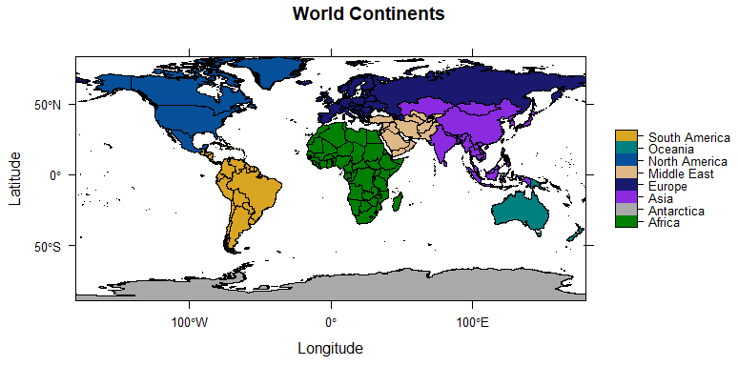
Manipulating Shapefiles with R
Import the Countries shapefile, and visualise it based on continent
Countries <- readOGR(dsn=path.expand("Data/Week_3/GIS"), layer="Countries")
Continents_col <- c("#008000","#a9a9a9","#8a2be2","#191970","#deb887","#055099","#008080","#daa520")
spplot(Countries, zcol="Continent", col.regions=Continents_col, main='World Continents',scales=list(draw=TRUE),xlab='Longitude',ylab='Latitude')

Slide 12
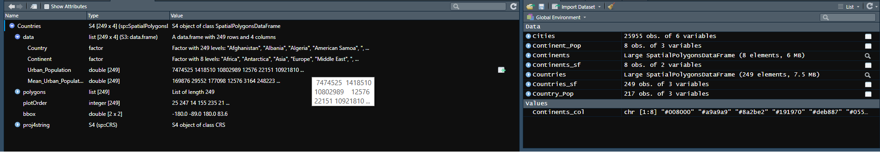
Manipulating Shapefiles with R
Now we can add the additional data we created to the shapefile data/attributes
ensures that even countries with no cities are added to the data
require(sp)
Countries@data <- merge(Countries@data, Country_Pop, by="Country", all=TRUE)
all=TRUE

Slide 13
Manipulating Shapefiles with R
Shapefiles with multiple features can also be combined
For instance, multiple polygons (Countries) with shared attributes (Continents) can be combined
Sf is required, and so the Countries.shp must be imported using sf
They can then be transformed into SpatialPolygons again before finally being exported, complete with additional data
Countries_sf <- sf::st_read(dsn=path.expand("Data/Week_3/GIS"), layer="Countries")
Continents_sf <- Countries_sf %>%
group_by(Continent) %>%
summarise(geometry = sf::st_union(geometry)) %>%
ungroup()
Continents <- as(Continents_sf, "Spatial")
Continents@data <- merge(Continents@data, Continent_Pop, by="Continent", all=TRUE)
writeOGR(Countries, dsn = path.expand(“…"), layer = 'Countries_Data', driver = "ESRI Shapefile")
writeOGR(Continents, dsn = path.expand(“…"), layer = 'Continents_Data', driver = "ESRI Shapefile")

Slide 14
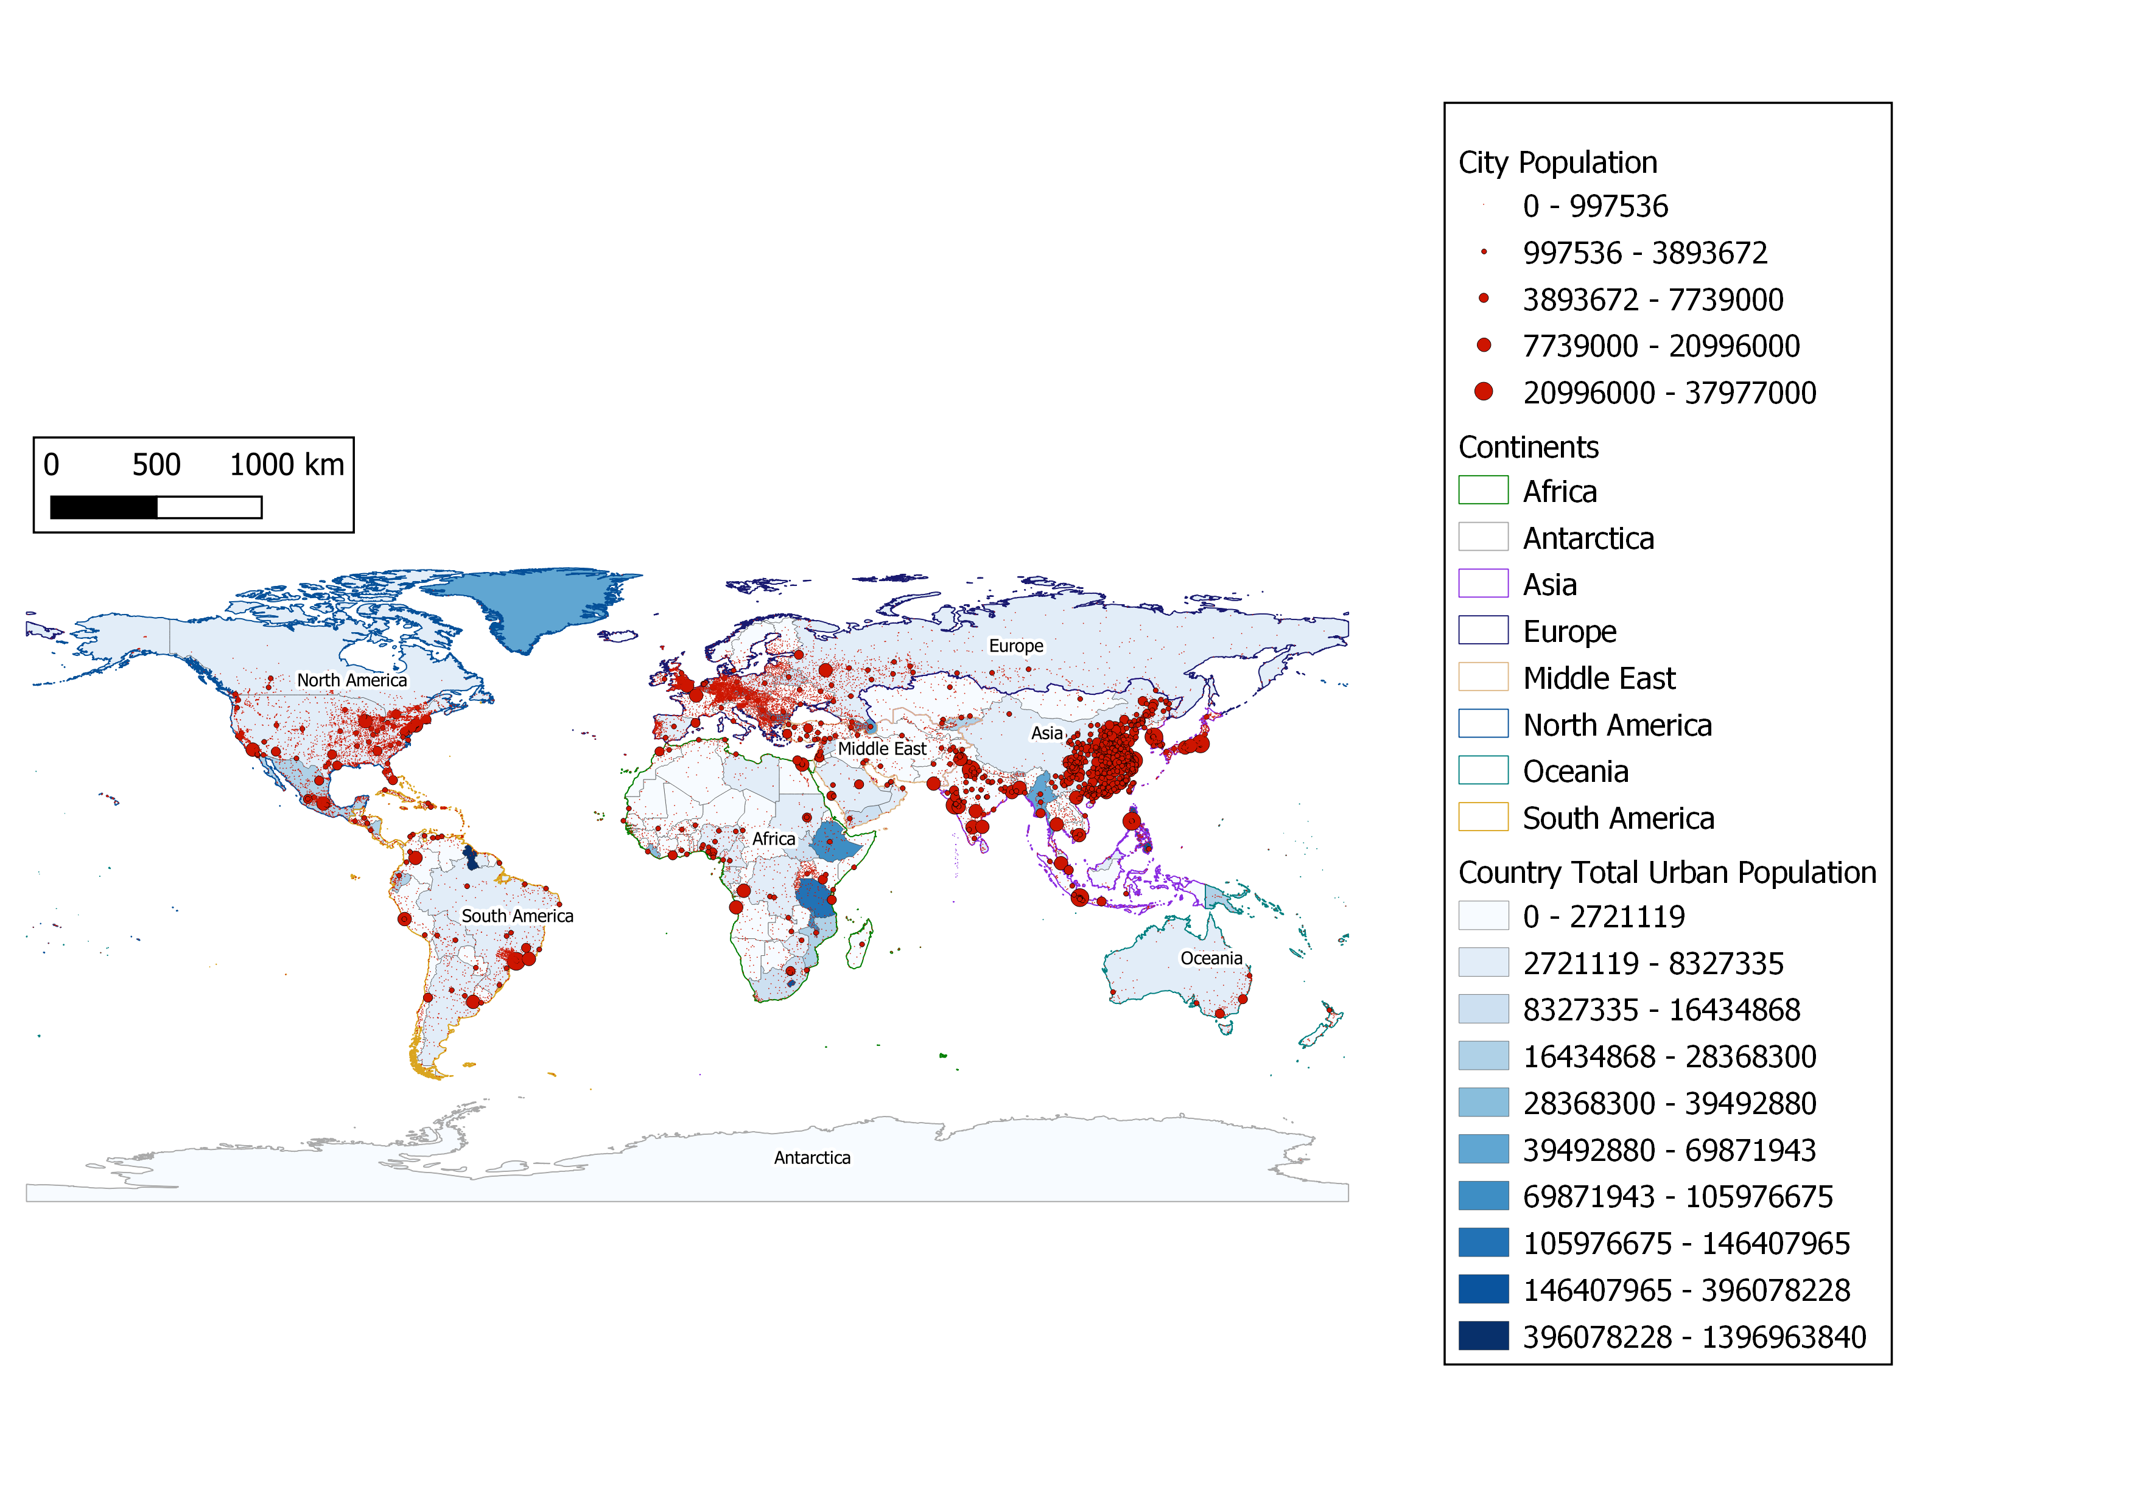
Back to QGIS!
With all of the additional data generated and combined in R, even deeper visualisation is possible through QGIS (or indeed R)

Slide 15
Back to QGIS!
We started with a Cities.csv with city names, coordinates and population
Additionally, we had a shapefile with Countries and Continents
By integrating R and QGIS, we managed to use only this information to show total urban population data by country and continent

Slide 16

These are just some examples…
Any questions or thoughts?

